Slide 1
18ECC203J – Module 1 Intel 8086 – Architecture, Signals and Features S – 6, 7 (1 of 2)
Prepared by,
Dr. R. Manohari
Dr.T.Rajalakshmi

Slide 2
S – 6 Instruction queue and pipelining & Segmentation of memory used with 8086
S – 7 (1 of 2) Methods of generating physical address
in 8086 & Pin signals of 8086: Common signals

Slide 3
The Queue Operation

Slide 4
Queue Operation cont…
The 8086 has a 6-byte instruction prefetch queue.
Thus even the largest (6-byte) instruction can be prefetched from the memory and stored in the prefetched queue.
This results in a faster execution of the instruction.
In the beginning, the CS:IP is loaded with the required address from which the execution is to be started.
Initially, the queue will be empty and the microprocessor starts a fetch operation to bring one byte (the first byte) of instruction code, if the CS:IP address is odd or two bytes at a time, if the CS:IP address is even.
When the first byte from queue goes for decoding and interpretation, one byte in the queue becomes empty and subsequently the queue is updated.
The microprocessor does not perform the next fetch operation till at least two bytes of the instruction queue are emptied.

Slide 5
Queue Operation cont…
The queue is updated after every byte is read from the queue but the fetch cycle is initiated by BIU only if at least two bytes of the queue are empty and the EU may be concurrently executing the fetched instructions.
The next byte after the instruction is completed is again the first opcode byte of the next instruction.
A similar procedure is repeated till the complete execution of the program.
The fetch operation of the next instruction is overlapped with the execution of the current instruction.
While the execution unit is busy in executing an instruction, after it is completely decoded, the bus interface unit may be fetching the bytes of the next instruction from memory, depending upon the queue ststus.

Slide 6
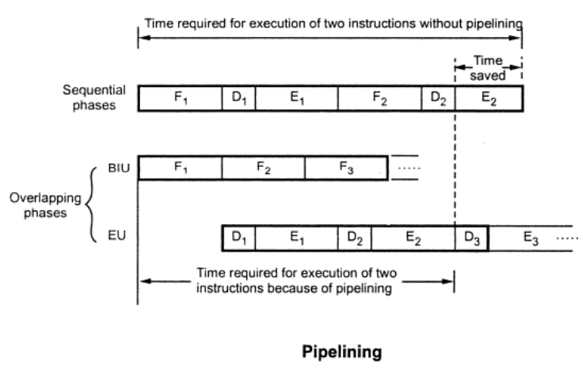
Instruction Byte Queue
To increase the execution speed, BIU fetches as many as six instruction bytes ahead to time from memory.
All six bytes are then held in first-in-first-out 6-byte register called instruction queue.
Queue operates on the principle first in first out (FIFO)
Fetching the next instruction while the current instruction executes is called pipelining

Slide 7
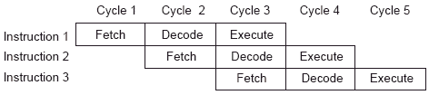
Pipelining

Slide 8
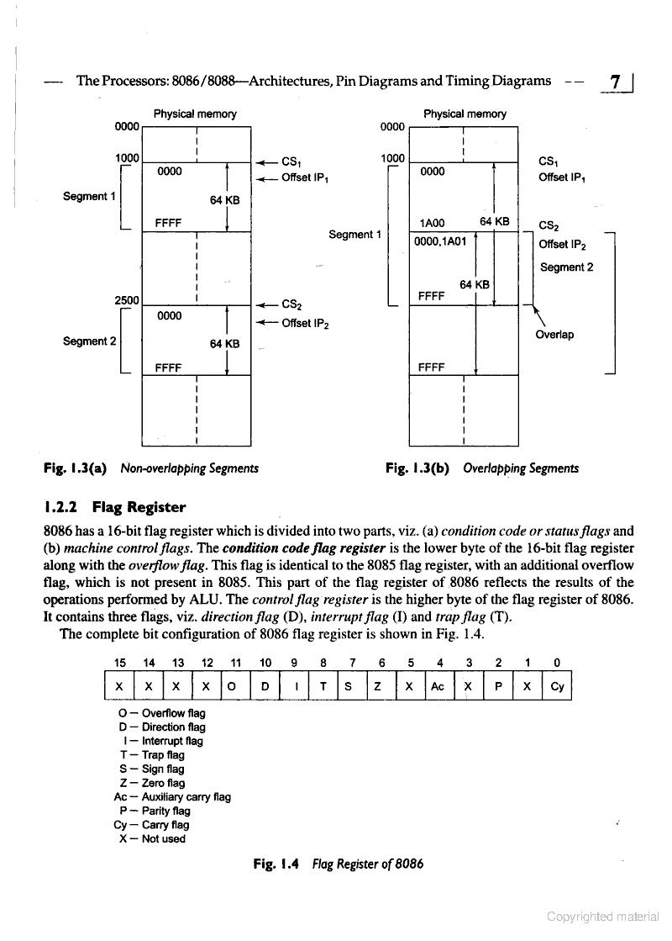
Memory Segmentation

Slide 9
Memory Segmentation cont…
The CPU 8086 is able to address 1Mbytes of physical memory.
The complete 1Mbytes memory can be divided into 16 segments, each of 64Kbytes size.
The address of the segments may be assigned as 0000H t0 F000H respectively.
The offset address values are from 0000H t0 FFFFH so that the physical addresses range from 00000H to FFFFFH.
In the above said case, the segments are called non-overlapping segments.
If another segment starts before 64Kbytes of the first segment, the two segments are said to be overlapping segments.
The area of memory from the start of the second segment to the possible end of the first segment is called an overlapped segment area.

Slide 10
Memory Segmentation cont…
The location lying in the overlapped area may be addressed by the same physical address generated from two different sets of segment and offset addresses.
In the overlapped area locations Physical Address = CS₁+IP₁ = CS₂+IP₂
The main advantages of the segmented memory scheme are as follows:
Allows the memory capacity to be 1Mbytes although the actual addresses to be handled are of 16-bit size
Allows the placing of code, data and stack portions of the same program in different parts (segment) of memory, for data and code protection
Permits a program and/or its data to be put into different areas of memory each time the program is executed, i.e. provision for relocation is done.

Slide 11
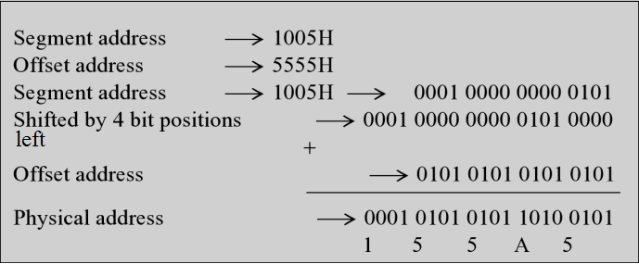
Cont.
The complete physical address which is 20-bits long is generated using segment registers and offset registers, each 16 bits long.

Slide 12
Physical Memory Organisation
Certain locations in memory are reserved for specific CPU operations. The locations from FFFF0H to FFFFFH are reserved for operations including jump to initialisation programme and I/O-processor initialisation.
The locations 00000H to 003FFH are reserved for interrupt vector table.

Slide 13
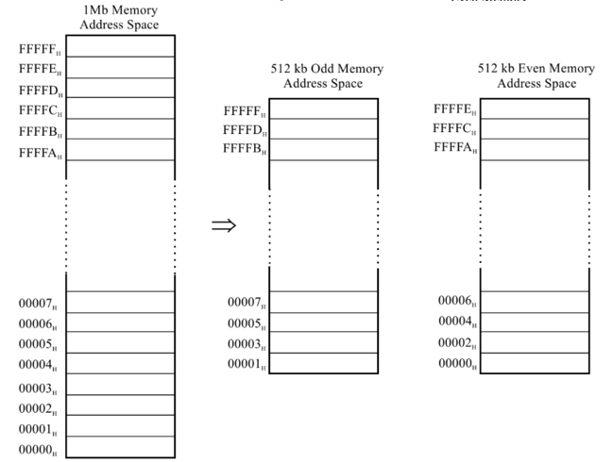
Organization of even and odd memory banks in an 8086 based system

Slide 14
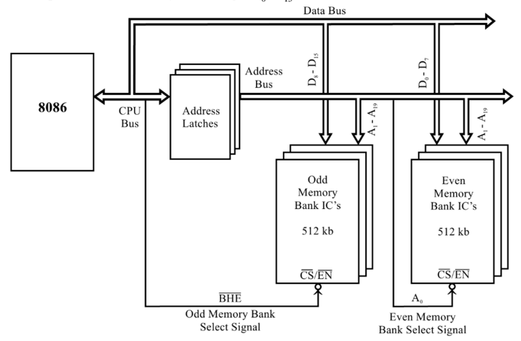
Addressing Memory

Slide 15
Thank You

